Slide 1




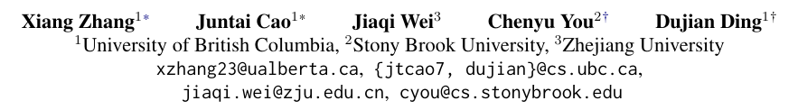





ATAI
Advanced Technique of Artificial Intelligence
ATAI
ChongqingUniversity _{AdvancedTechniqueof}
of Technology Artificial Intelligence
Chongqing University of Technology
Chongqing University ^{ATAI}
_{of Technology} Advanced Techniqueof
Artificial Intelligence
Chongqing University of Technology
Chongqing University of Technology
Why Prompt Design Matters and Works:
A Complexity Analysis of Prompt Search Space in LLMs
code: None
—— ACL ’25
Reported by Jinfei Chen
1

Slide 2
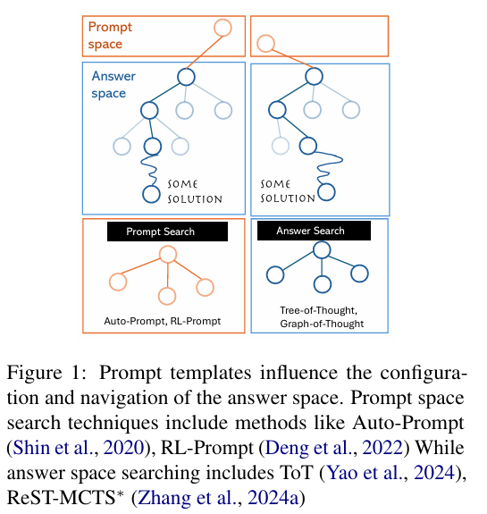
ATAI
Advanced Technique of
Artificial Intelligence
ATAI
ChongqingUniversity _{AdvancedTechniqueof}
of Technology Artificial Intelligence
Chongqing University of Technology
Motivation
Despite the remarkable successes of Large Language Models (LLMs), the underlying Transformer architecture has inherent limitations in handling complex reasoning tasks.
Chain of-Thought (CoT) prompting has emerged as a practical workaround, but most CoT-based methods rely on a single generic prompt like “think step by step,” with no task-specific adap tation.
These approaches expect the model to discover an effective reasoning path on its own, forcing it to search through a vast prompt space. In contrast, many work has explored task-specific prompt designs to boost performance.
However, these designs are typically developed through trial and error, lacking a theoretical ground. As a result, prompt engineering remains largely ad hoc and unguided.
Notes:
因此，提示工程在很大程度上仍然是临时性的且缺乏指导。

Slide 3
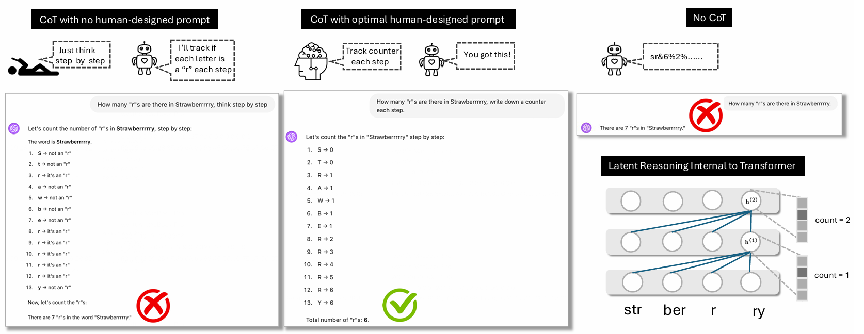
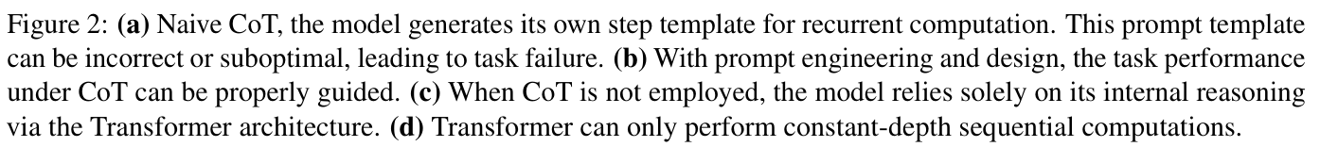
ATAI
Advanced Technique of
Artificial Intelligence
ATAI
ChongqingUniversity _{AdvancedTechniqueof}
of Technology Artificial Intelligence
Chongqing University of Technology

Slide 4
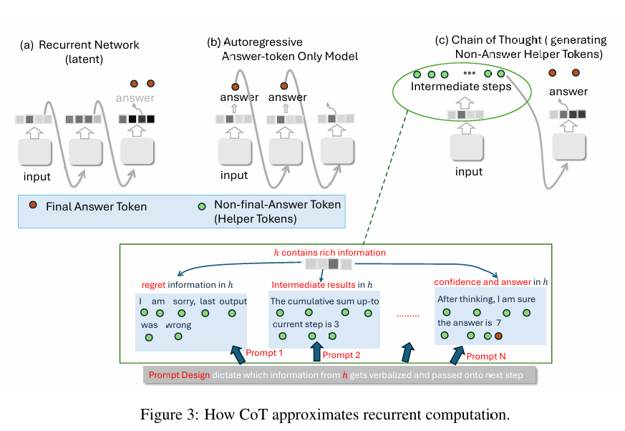
ATAI
Advanced Technique of
Artificial Intelligence
ATAI
ChongqingUniversity _{AdvancedTechniqueof}
of Technology Artificial Intelligence
Chongqing University of Technology

Slide 5
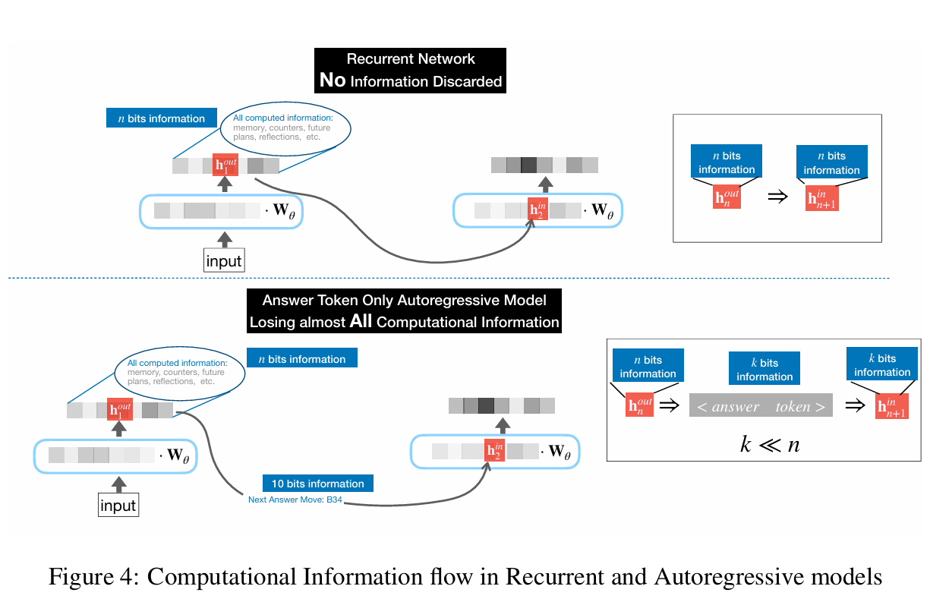
ATAI
Advanced Technique of
Artificial Intelligence
ATAI
ChongqingUniversity _{AdvancedTechniqueof}
of Technology Artificial Intelligence
Chongqing University of Technology

Slide 6
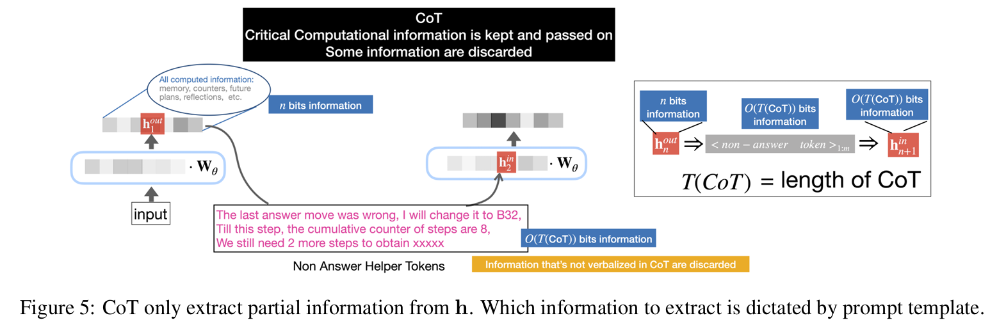
ATAI
Advanced Technique of
Artificial Intelligence
ATAI
ChongqingUniversity _{AdvancedTechniqueof}
of Technology Artificial Intelligence
Chongqing University of Technology

Slide 7
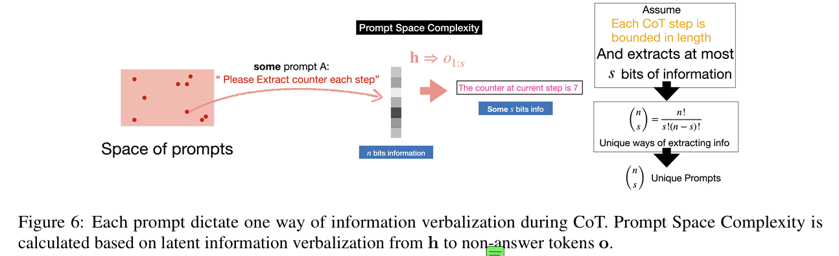
ATAI
Advanced Technique of
Artificial Intelligence
ATAI
ChongqingUniversity _{AdvancedTechniqueof}
of Technology Artificial Intelligence
Chongqing University of Technology

Slide 8
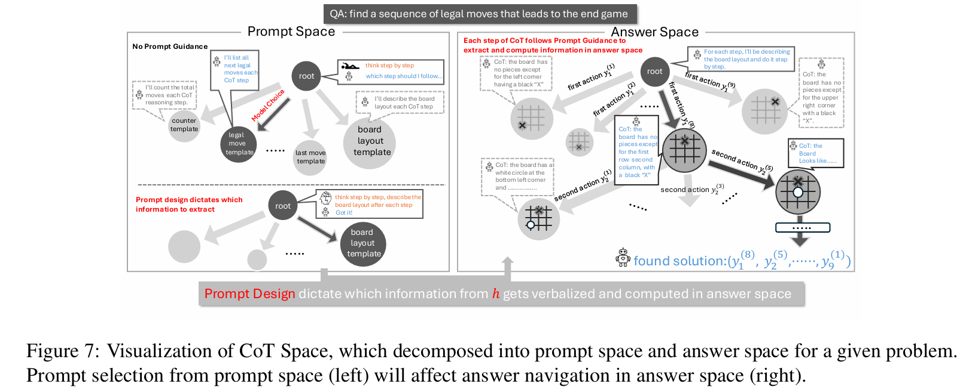

ATAI
Advanced Technique of
Artificial Intelligence
ATAI
ChongqingUniversity _{AdvancedTechniqueof}
of Technology Artificial Intelligence
Chongqing University of Technology

Slide 9
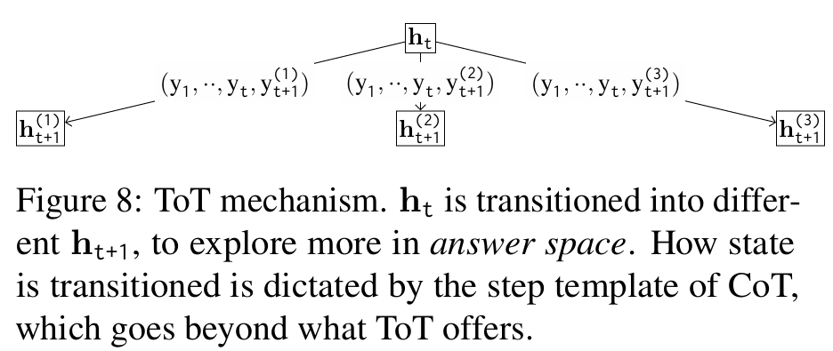
ATAI
Advanced Technique of
Artificial Intelligence
ATAI
ChongqingUniversity _{AdvancedTechniqueof}
of Technology Artificial Intelligence
Chongqing University of Technology

Slide 10
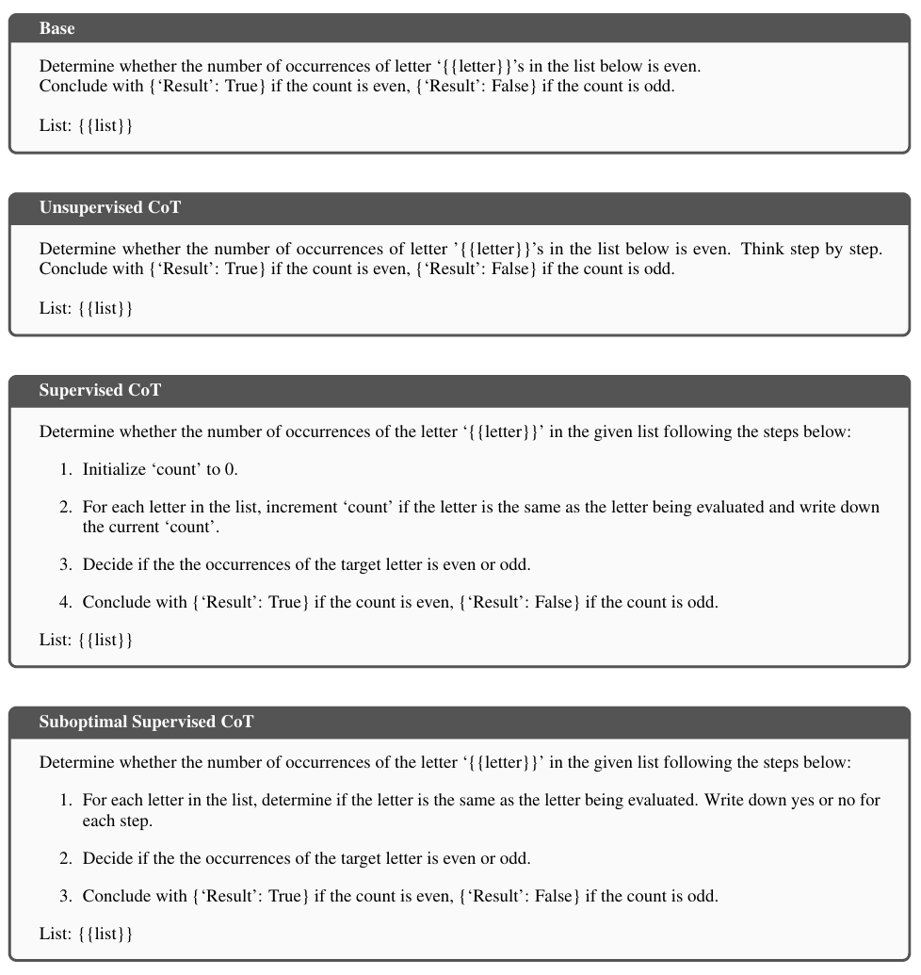
ATAI
Advanced Technique of
Artificial Intelligence
ATAI
ChongqingUniversity _{AdvancedTechniqueof}
of Technology Artificial Intelligence
Chongqing University of Technology

Slide 11
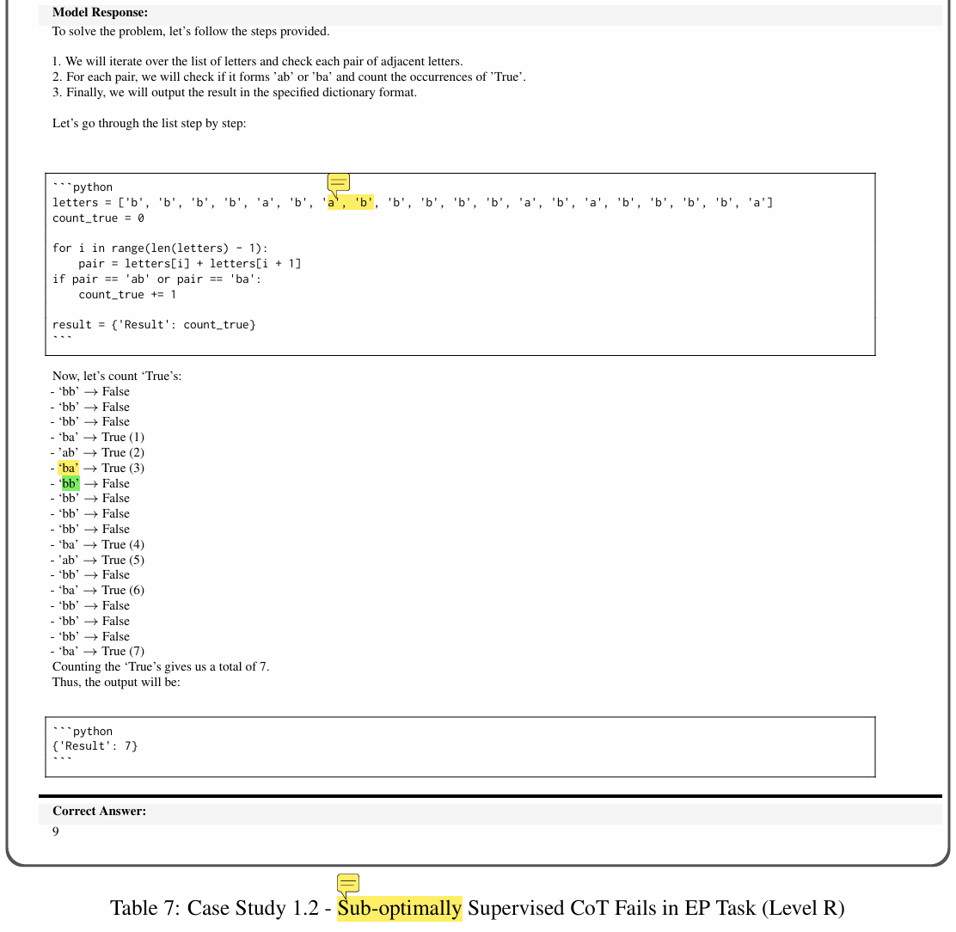
ATAI
Advanced Technique of
Artificial Intelligence
ATAI
ChongqingUniversity _{AdvancedTechniqueof}
of Technology Artificial Intelligence
Chongqing University of Technology

Slide 12
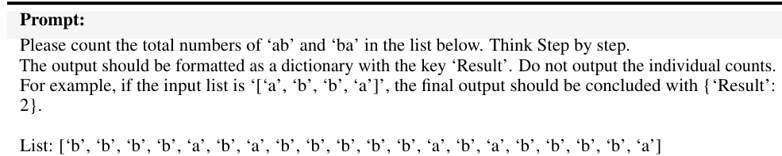
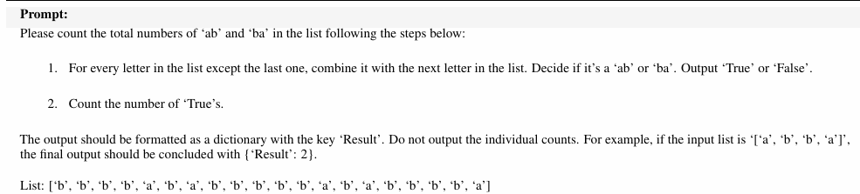
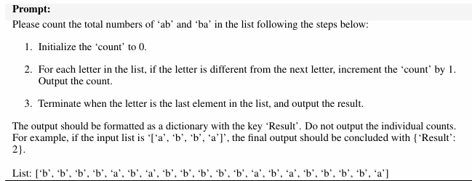
ATAI
Advanced Technique of
Artificial Intelligence
ATAI
ChongqingUniversity _{AdvancedTechniqueof}
of Technology Artificial Intelligence
Chongqing University of Technology

Slide 13
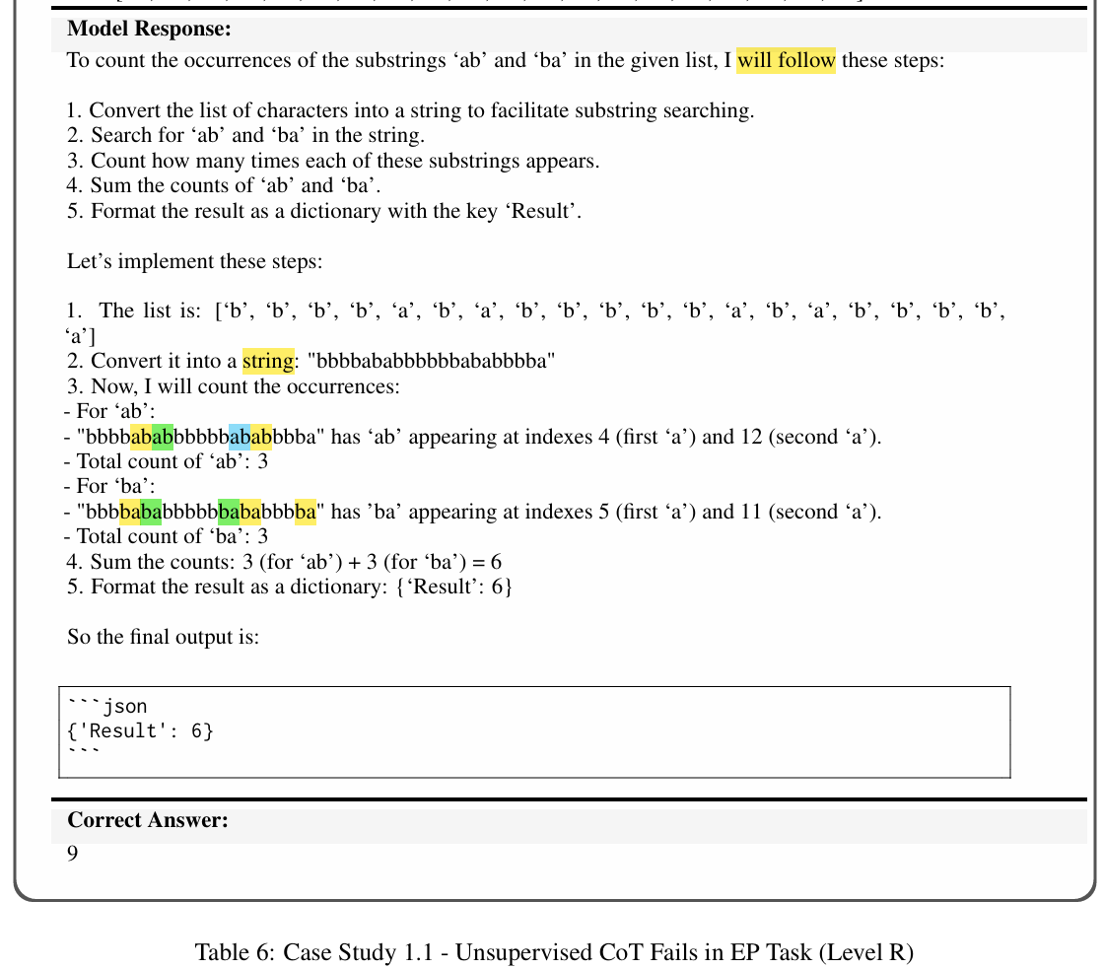
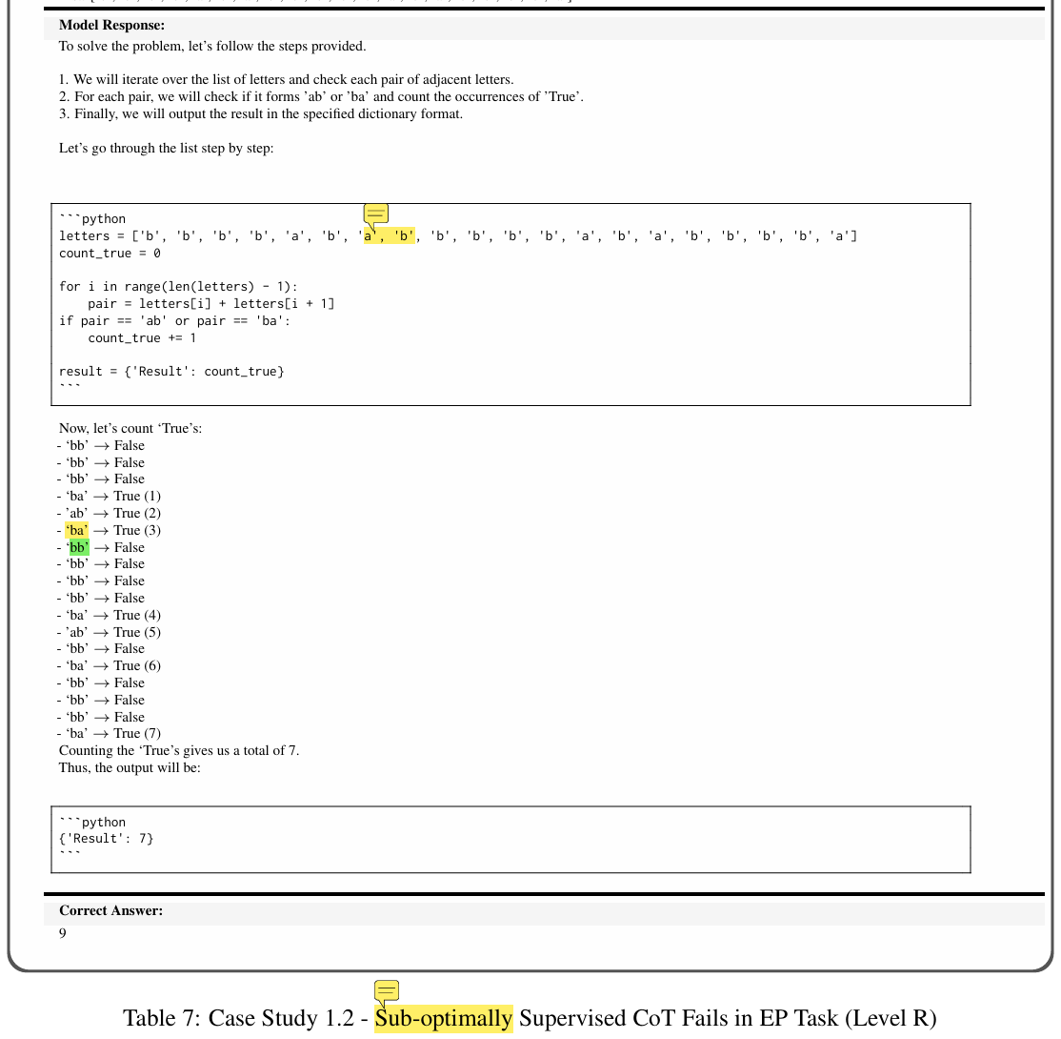
ATAI
Advanced Technique of
Artificial Intelligence
ATAI
ChongqingUniversity _{AdvancedTechniqueof}
of Technology Artificial Intelligence
Chongqing University of Technology

Slide 14
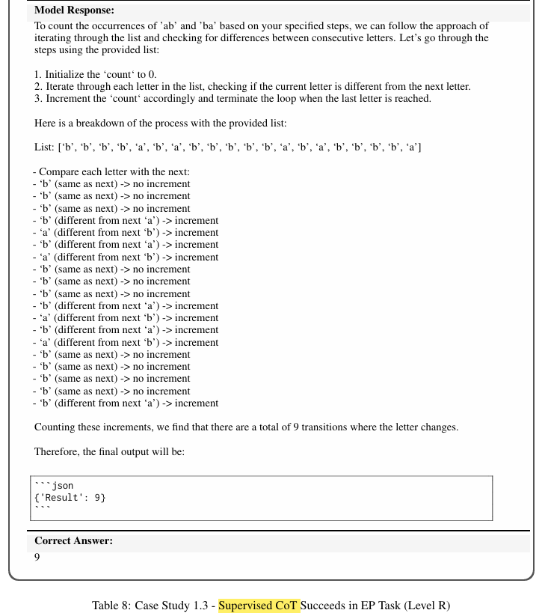
ATAI
Advanced Technique of
Artificial Intelligence
ATAI
ChongqingUniversity _{AdvancedTechniqueof}
of Technology Artificial Intelligence
Chongqing University of Technology

Slide 15
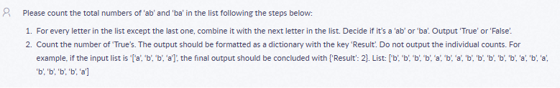
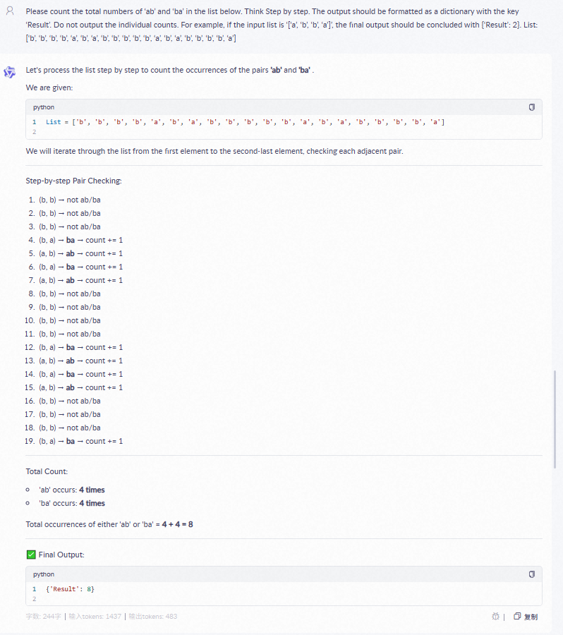
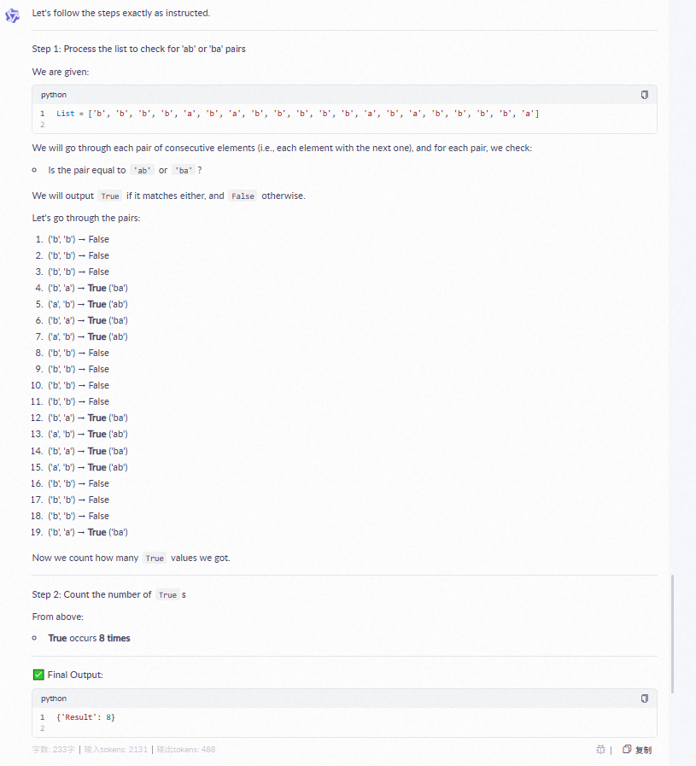
ATAI
Advanced Technique of
Artificial Intelligence
ATAI
ChongqingUniversity _{AdvancedTechniqueof}
of Technology Artificial Intelligence
Chongqing University of Technology

Slide 16
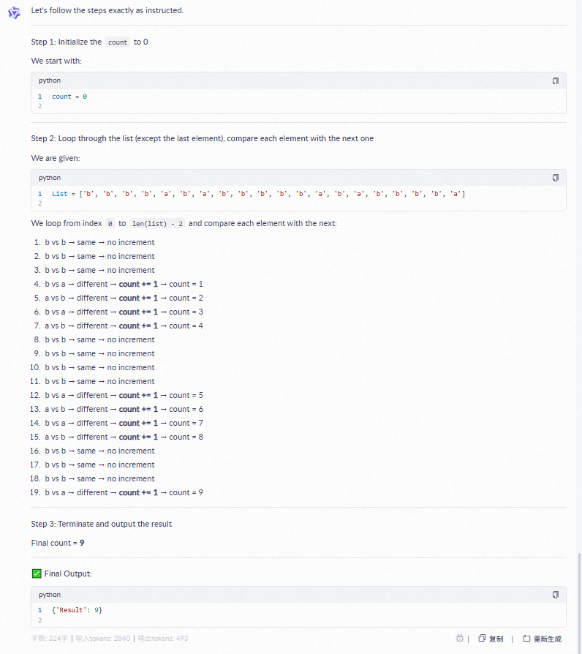
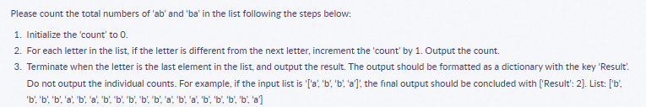
ATAI
Advanced Technique of
Artificial Intelligence
ATAI
ChongqingUniversity _{AdvancedTechniqueof}
of Technology Artificial Intelligence
Chongqing University of Technology

Slide 17
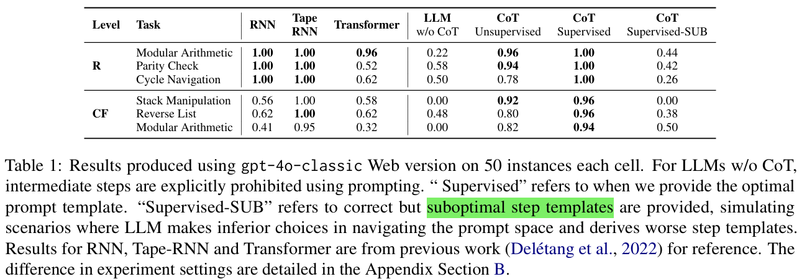
ATAI
Advanced Technique of
Artificial Intelligence
ATAI
ChongqingUniversity _{AdvancedTechniqueof}
of Technology Artificial Intelligence
Chongqing University of Technology
Experiments

Slide 18
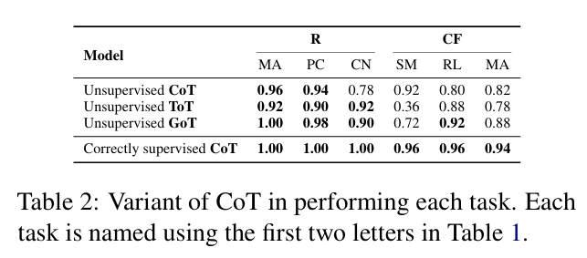
ATAI
Advanced Technique of
Artificial Intelligence
ATAI
ChongqingUniversity _{AdvancedTechniqueof}
of Technology Artificial Intelligence
Chongqing University of Technology
Experiments

Slide 19


ATAI
Advanced Technique of
Artificial Intelligence
ATAI
ChongqingUniversity _{AdvancedTechniqueof}
of Technology Artificial Intelligence
Chongqing University of Technology
Thanks!

